Slide 1

Customer Shopping Behavior Analysis
Uncovering insights from 3,900 purchases across product categories to guide strategic business decisions through data-driven analysis.

Slide 2

Dataset Overview
3,900 Purchases
18 Columns
Transactional records analyzed
Demographics, purchase details, behavior
37 Missing Values
Review Rating column imputed with median
Key features include customer demographics, purchase details across 25 product categories, shopping behavior metrics, and subscription status.

Slide 3
Data Preparation & Cleaning
01
02
03
Data Loading
Initial Exploration
Missing Data Handling
Imported dataset using pandas for Python analysis
Checked structure and generated summary statistics
Imputed Review Rating with median by product category
04
05
Feature Engineering
Database Integration
Created age groups and purchase frequency metrics
Loaded cleaned data into PostgreSQL for SQL analysis

Slide 4
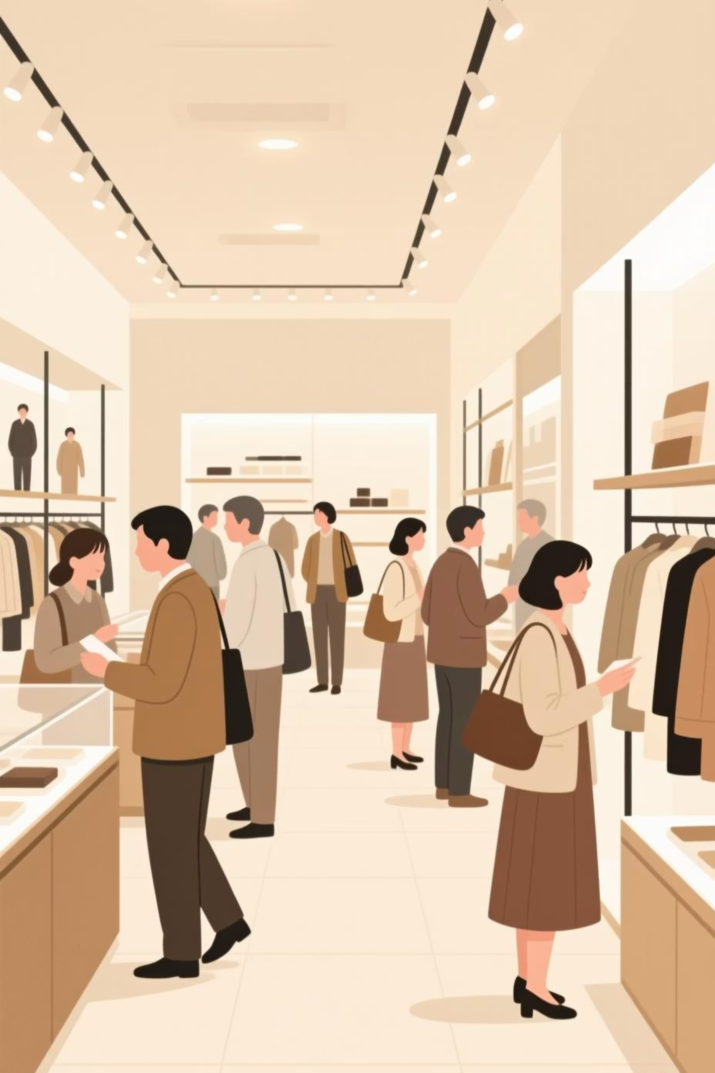
Revenue Insights by Demographics
Revenue by Gender
Revenue by Age Group
Male: $157,890
Young Adult: $62,143
Female: $75,191
Middle-aged: $59,197
Male customers generate 68% of revenue, indicating significant growth opportunity in female segment.
Adult: $55,978
Senior: $55,763

Slide 5

Subscription Impact on Revenue
1,053
2,847
958
Subscribers
Non-Subscribers
Repeat Buyers
$62,645 total revenue
$170,436 total revenue
With subscription status
2,518
Repeat Buyers
Without subscription
Non-subscribers represent 73% of customer base with significant revenue potential for conversion campaigns.

Slide 6





Product Performance & Preferences
Clothing
Footwear
Top category with 1,737 purchases
Sandals, Shoes, Sneakers lead
Outerwear
Accessories
Jackets and Coats drive sales
Jewelry, Sunglasses, Belts popular
Top-rated products: Gloves (3.86), Sandals (3.84), Boots (3.82) average ratings.

Slide 7
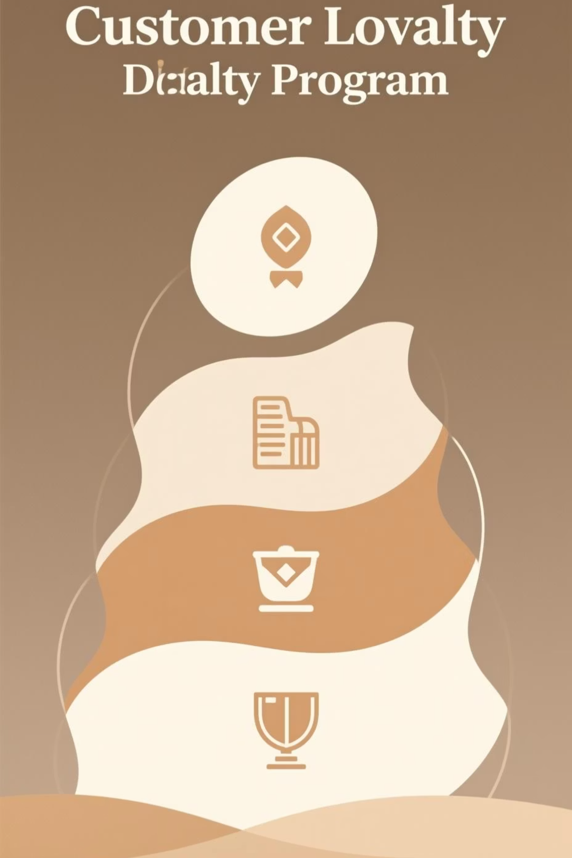
Customer Segmentation & Loyalty
Loyal Customers
Returning Customers
3,116 customers
701 customers
New Customers
83 customers
80% of customer base is loyal, with significant opportunity to convert new and returning customers into repeat buyers through targeted engagement strategies.

Slide 8

Discount & Promotion Behavior
High Discount Dependency
Shipping Preferences
Standard: $58.46 avg spend
Hat: 50% discount rate
Express: $60.48 avg spend
Sneakers: 49% discount rate
Express shipping customers spend slightly more, indicating willingness to pay for convenience.
Coat: 49% discount rate
Certain products rely heavily on discounts to drive sales.

Slide 9
Strategic Recommendations
1
Launch Subscription Conversion Campaign
2
Grow Female Customer Segment
Expand 32% female base through targeted marketing analyzing current female purchasing habits.
Target 2,847 non-subscribers with incentives to convert into recurring revenue stream.
3
Implement Cross-Sell Strategy
4
Segment Marketing by Purchase Frequency
Use top-performing Clothing category to recommend Accessories and Footwear at checkout.
Customize email cadences: "New Arrivals" for weekly shoppers, "Seasonal Stock-up" for quarterly/annual buyers.

Slide 10
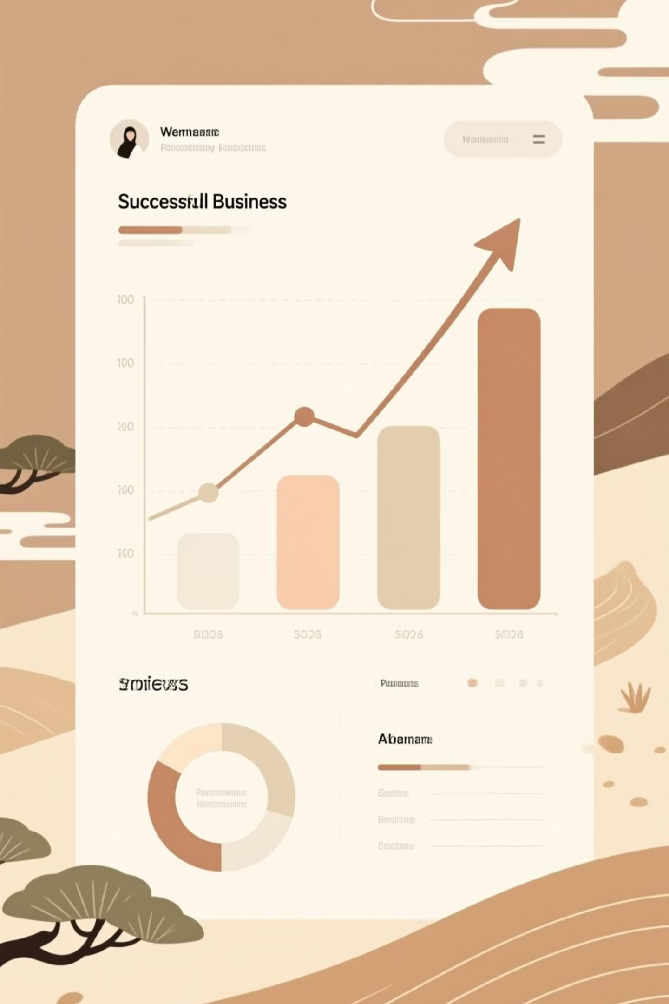
Key Takeaways
Data-Driven Insights
Revenue Optimization
3,900 purchases analyzed across 18 features reveal clear customer patterns and opportunities.
$233,081 total revenue with untapped potential in female segment and subscription conversions.
Customer Focus
80% loyal customer base provides strong foundation for targeted growth initiatives and retention.

